Slide 1


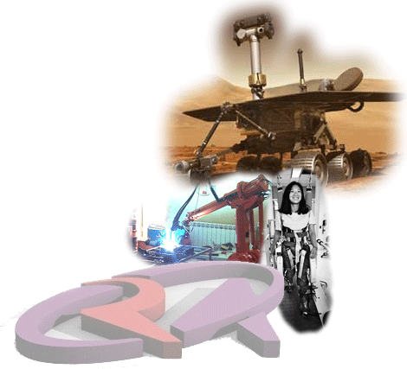
Welcome to the
IEEE
Robotics & Automation
Society!
http://www.ieee-ras.org

Slide 2
Introduction to the
IEEE Robotics and Automation Society (RAS)
Bruno Siciliano, Senior Past-President of RAS
Distinguished Ambassadors Program
http://www.ieee-ras.org

Slide 3
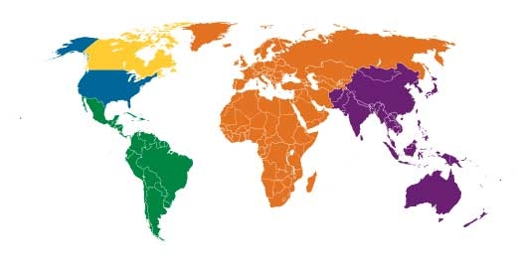
IEEE
The world’s largest technical professional association fostering technological innovation and excellence for the benefit of humanity
  More than 400,000 members
  Includes 100,000 student members
  More than 150 countries
Organized into 10 geographical regions
  330 sections
  ~1900 student branches
  ~2000 chapters

Slide 4




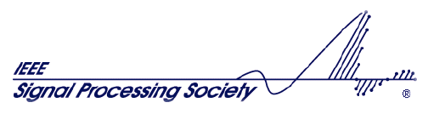
IEEE
Composed of 10 technical divisions
  Technical areas ranging from aerospace systems, computers, and control systems to electron devices, power & energy, and signal processing
  38 societies and 7 technical councils

Slide 5
IEEE
Composed of 10 technical divisions
  Technical areas ranging from aerospace systems, computers, and control systems to electron devices, power & energy, and signal processing
  38 societies and 7 technical councils
  Robotics and Automation Society in Division X

Slide 6
History of IEEE
American Institute of Electrical Engineers (AIEE), 1884
  Norvin Green of Western Union from telegraphy, Thomas Edison from power, and Alexander Graham Bell from the telephone industry (Edison and Bell were among six VPs)
Institute of Radio Engineers (IRE), 1912, devoted to radios
They merged to form IEEE in 1963
We celebrated 125th anniversary in 2009
  Publishes nearly 150 transactions, journals and magazines
  Sponsors more than 1300 conferences annually
  Many standards

Slide 7
Robotics and Automation Society (RAS)
RAS has over 11000 members in 110 countries
  Roughly half in the Americas
  A quarter in Europe and the Middle East
  A quarter in Asia and Oceania
Students make up about
15% of the RAS membership
  Growing rapidly
  Increased by 45% in 2011

Slide 8
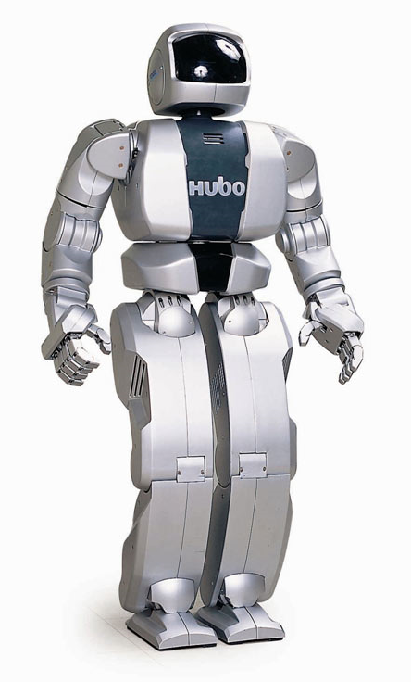
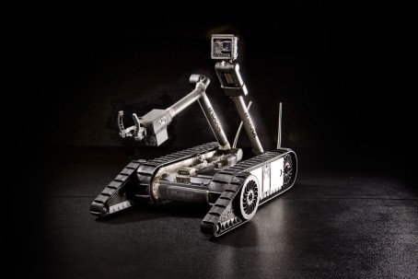
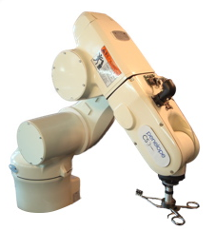
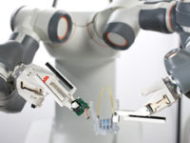

RAS Technical Field of Interest
The Society is interested in both applied and theoretical issues in robotics and automation
Robotics: include intelligent machines and systems used, for example, in space exploration, human services, or manufacturing
iRobot PackBot
KAIST Hubo
Automation: use of automated methods in various applications, for example, factory, office, home, or transportation systems to improve performance and productivity
ABB FRIDA
RST PenelopeCS

Slide 9

What Does RAS Do?
RAS fosters research and education, professional development and industrial and commercial applications of R&A through:
  Conferences
  Workshops and tutorials
  Publications
  Technical committees
  Local and student chapters
  Summer schools
  Other activities

Slide 10

RAS Conferences
ICRA (International Conference on Robotics and Automation): RAS’s flagship conference
Established in 1984
ICRA 2012: St. Paul, Minnesota USA
  Over 1500 participants
  800⁺ presentations of papers and videos
ICRA 2013: Karlsruhe, Germany

Slide 11
RAS Conferences
Fully sponsored (9)
  ARSO IEEE Workshop on Advanced Robotics and its Social Impacts
  CASE IEEE International Conference on Automation Science and Engineering
  CIRA IEEE International Symposium on Computational Intelligence in Robotics and Automation
  Haptics IEEE Haptics Symposium
  Humanoids IEEE-RAS International Conference on Humanoid Robots
  ICRA IEEE International Conference on Robotics and Automation
  ISAM IEEE International Symposium on Assembly and Manufacturing
  MEMS IEEE International Conference on Micro Electro Mechanical Systems
  SSRR IEEE International Symposium on Safety, Security, and Rescue Robotics
http://www.ieee-ras.org/calendar

Slide 12
RAS Conferences
Partially sponsored (15)
  70% MFI IEEE International Conference on Multisensor Fusion and Integration for Intelligent Systems
  60% WHC World Haptics Conference
  50% BioRob IEEE International Conference on Biomedical Robotics and Biomechatronics
  50% ICORR IEEE International Conference on Rehabilitation Robotics
  50% CYBER IEEE International Conference on Cyber Technology in Automation, Control, and Intelligent Systems
  50% ROBIO IEEE International Conference on Robotics and Biomimetics
  40% HRI ACM/IEEE International Conference on Human-Robot Interaction
  35% RO-MAN IEEE International Symposium on Robot and Human Interactive Communication
  33% AIM IEEE/ASME International Conference on Advanced Intelligent Mechatronics
  30% ICAL IEEE International Conference on Automation and Logistics
  30% ICIA IEEE International Conference on Information and Automation
  25% IROS IEEE/RSJ International Conference on Intelligent Robots and Systems
  25% ICMA IEEE International Conference on Mechatronics and Automation
  25% SII IEEE/SICE International Symposium on System Integration
  20% MHS International Conference on Micro-Nano Mechatronics and Human Science
IROS 2013 will be held in Tokyo, Japan, November 3-7, 2013
10+ technically cosponsored conferences

Slide 13
RAS Publications
IEEE Robotics and Automation Magazine
Two Journals:
  IEEE Transactions on Robotics
  IEEE Transactions on Automation Science and Engineering
Co-sponsor of 7 other journals with other IEEE and non-IEEE organizations (+ 4 technical co-sponsorships)
RAS Society Members
  Serve as editors and reviewers
  Oversee both technical and financial aspects of RAS publications

Slide 14
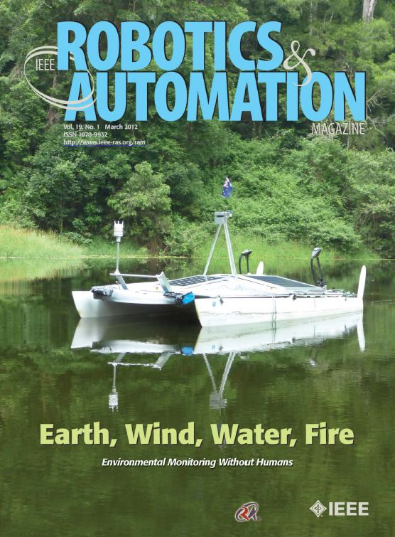
IEEE Robotics and Automation Magazine
Implementations of cutting-edge Robotics and Automation technology
Tutorials by leading researchers and educators
Research, education, industry, student, and society news
Special issues on topics of current interest

Slide 15
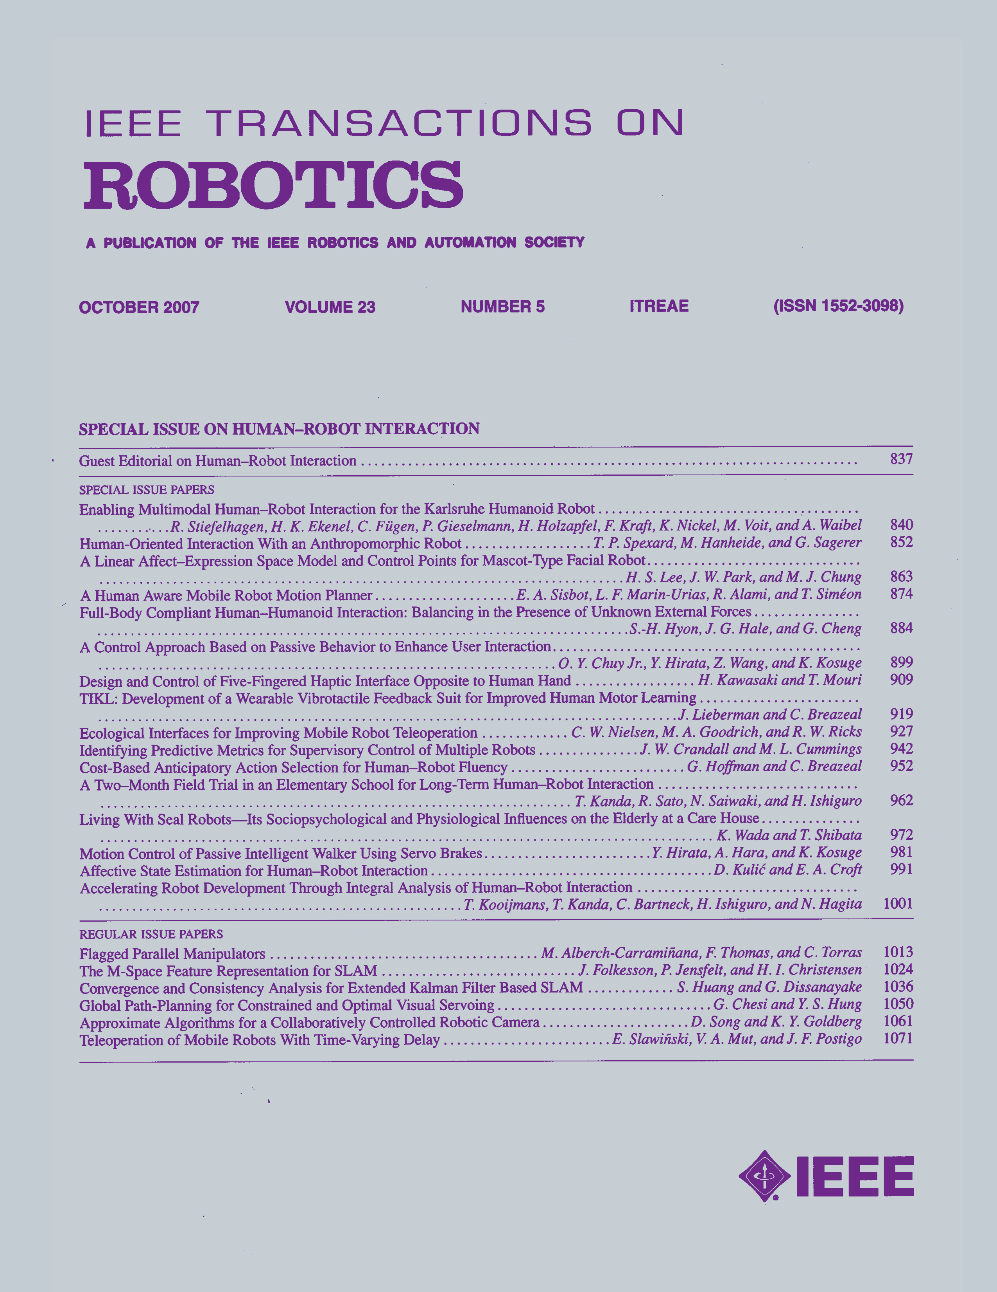
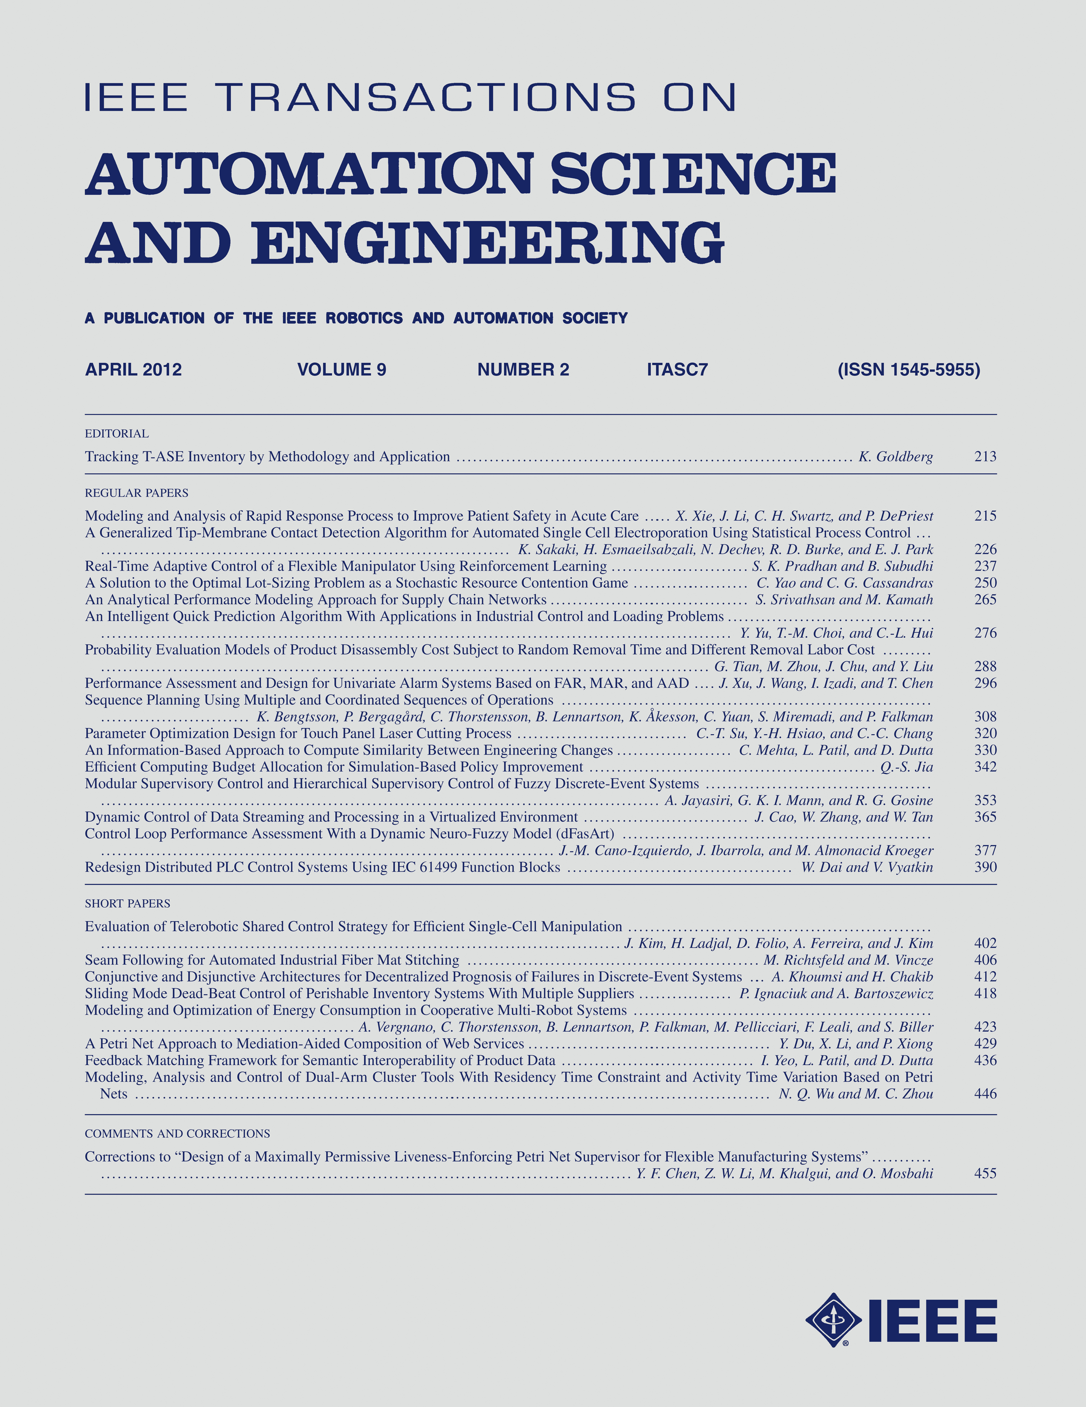
RAS Transactions
IEEE Transactions on Robotics
  Founded in 1985 as IEEE Journal of Robotics & Automation
  Annually rated among the top publications in Robotics (Thomson Journal Citation Reports)
IEEE Transactions on Automation Science and Engineering
  Founded in 2004
  Built a solid reputation for publishing
  high quality research results in the automation area

Slide 16
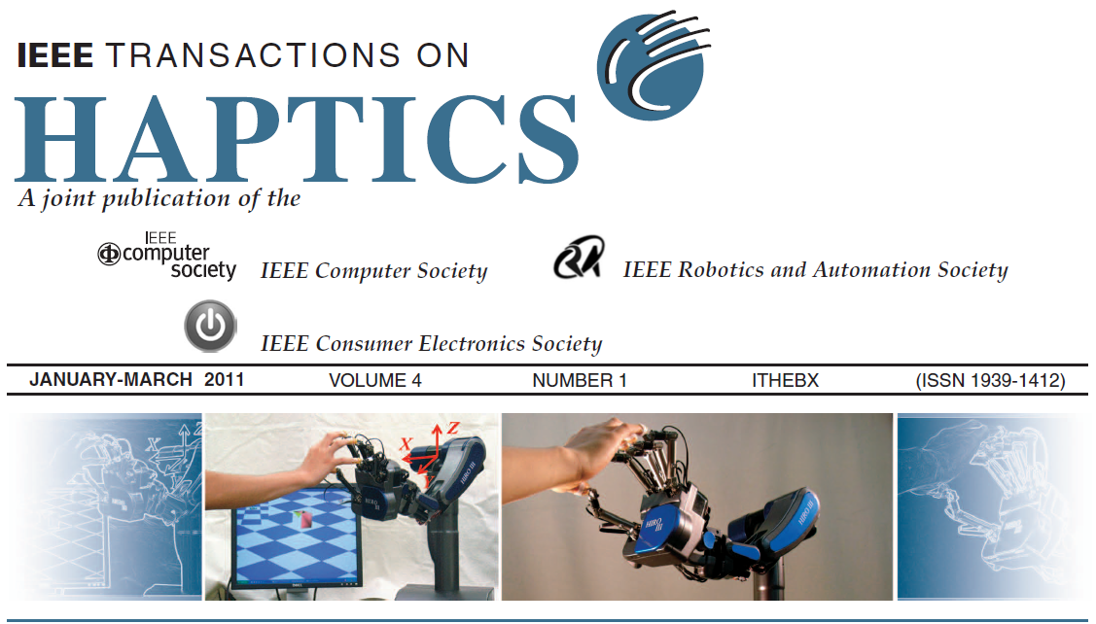

RAS Co-sponsored Journals
IEEE Transactions on Haptics
IEEE/ASME Transactions on Mechatronics
IEEE/ASME Journal of MEMS
IEEE Transactions on NanoBioscience
IEEE Transactions on Nanotechnology
IEEE Sensors Journal
IEEE Systems Journal

Slide 17
Technical Activities
IEEE-RAS Distinguished Lecturers
  RAS travel support for IEEE-RAS Distinguished Lecturers to visit local chapters
  Distinguished Lecturers available from Asia and Oceania, the Americas, and Europe
IEEE-RAS Technical Committees
  28 committees to promote technical activities across the diverse field of robotics and automation
  Opportunity to network with colleagues who share similar research interests
  Activities include workshops & tutorials, conferences, special issues of journals, web portal
http://www.ieee-ras.org/technical

Slide 18
Member Activities:
Local and Student Chapters
Local communities of R&A professionals and students
  Networking opportunities, professional development, continuing education
  More than 60 local chapters worldwide
  More than 35 student chapters worldwide
Chapter support
  RAS chapter grant, $2000/year to support local activities
  (mini-symposia, competitions, workshops, etc.)
  Distinguished Lecturer travel to local chapter (up to $3000)
  “Chapter of the Year” Award: $1000 grant, most active chapter
http://www.ieee-ras.org/member/chapters

Slide 19
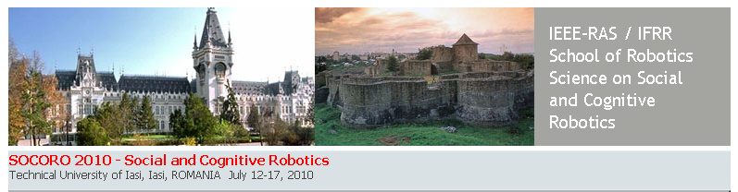
School of Robotics Science
Co-sponsored by IEEE-RAS and IFRR
Topics of past schools: Human-Robot Interaction, Robot Design, Haptic Interaction, Learning, Medical Robotics, Social and Cognitive Robotics
IEEE-RAS financial support to defray student fees
New Technical Education Program supports up to 3 schools per year (1 solely sponsored by IEEE RAS, 2 co-sponsored with other organizations)

Slide 20
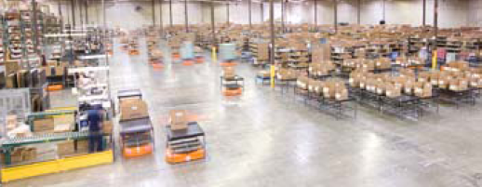
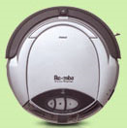
Industrial Activities
IEEE/IFR Forum on Innovation
and Entrepreneurship in
Robotics and Automation
  Co-sponsored by International
  Federation of Robotics
  Case studies in innovation and
  entrepreneurship
  IERA Award – $2000
KIVA Mobile Fulfillment System
2008
iRobot Roomba Floorvac
2005 (first award)
Industry Forum at ICRA
Standards – help drive industry forward and develop new products
Technology Watch and Industrial Activities columns
  Robotics and Automation Magazine
http://www.ieee-ras.org/industrial

Slide 21
IEEE RAS Membership
Starting in 2011, RAS has reduced its membership fee by more than 50%. Regular membership is just $9/year and student membership is $5/year.
Total regular IEEE + RAS membership: $64
Total student IEEE + RAS membership: $32.50

Slide 22
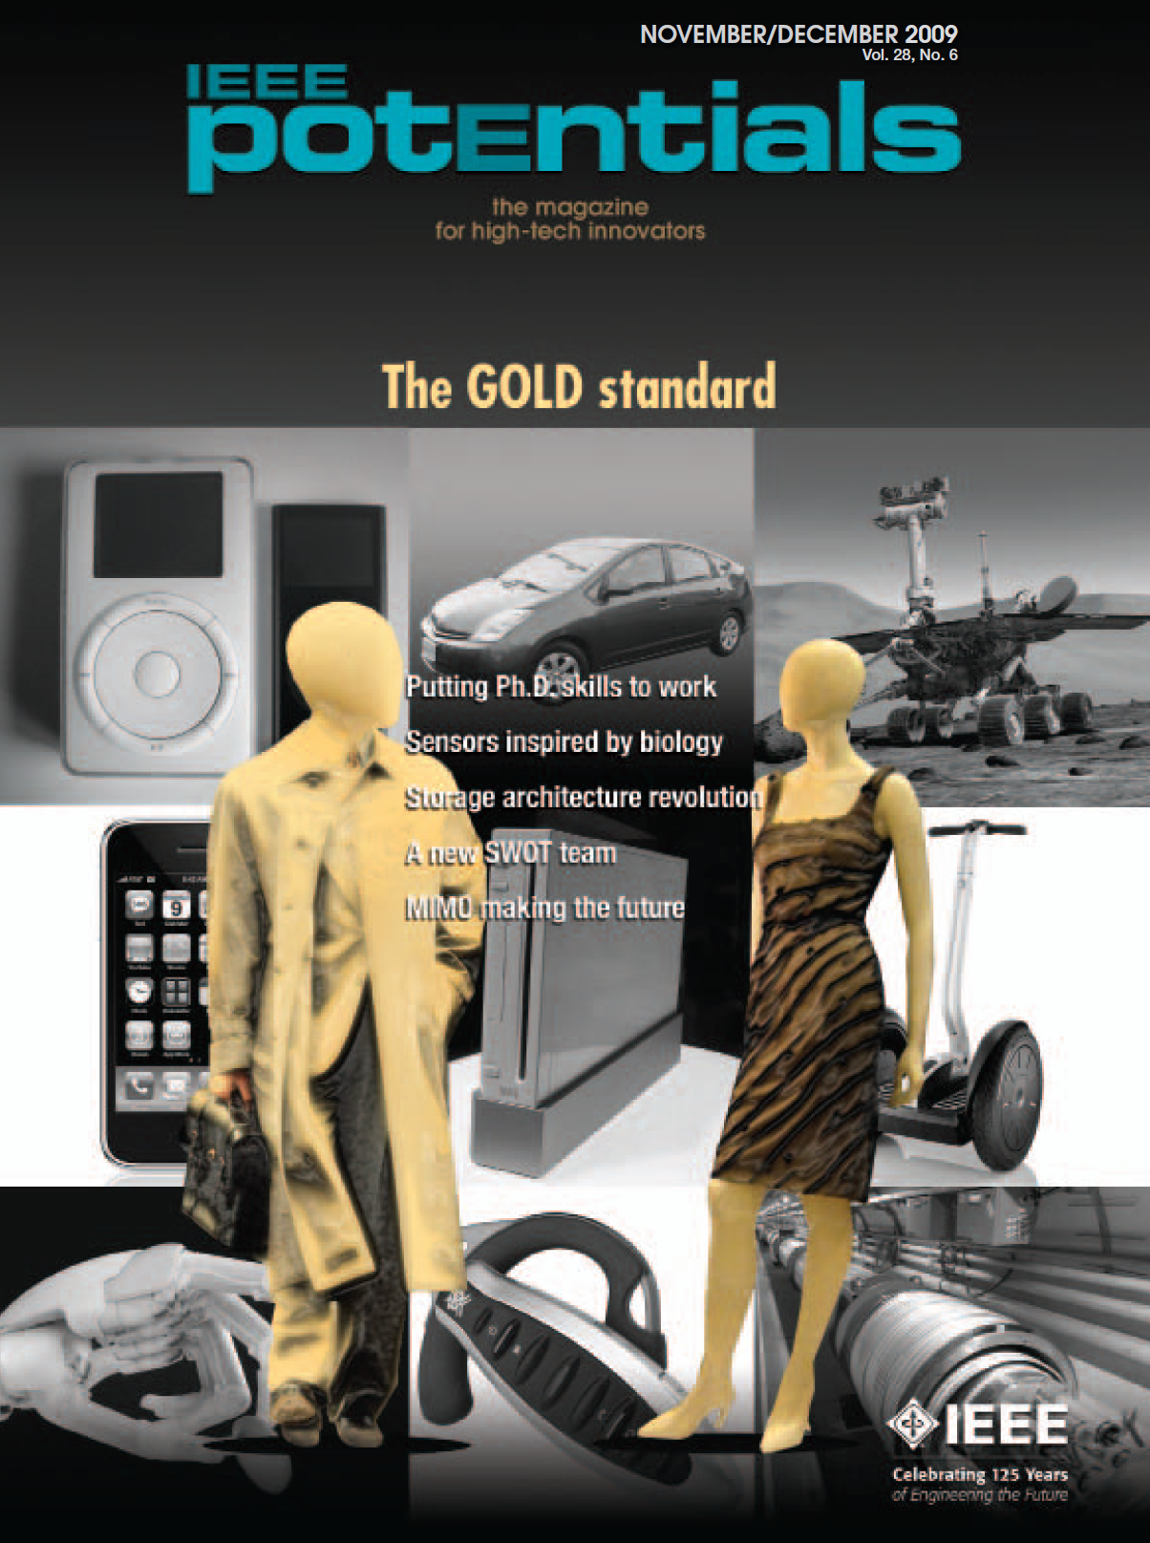
IEEE Membership Benefits
IEEE Spectrum Magazine
IEEE Potentials Magazine (students)
The Institute Newsletter
Networking opportunities for joint
research and career development
* Reduced rates for conference registration *
  ICRA 2012 in St Paul, Minnesota USA:
  IEEE member rate: $570, non-IEEE member rate: $770; difference is = $200;
  Student difference = $450 - $300 = $150

Slide 23

RAS Membership Benefits
e-subscriptions:
  IEEE Robotics and Automation Magazine
  IEEE Transactions on Robotics
  IEEE Transactions on Automation Science and Engineering
RAS online member directory
RAS video library
RASeNews – latest news, special events, conference announcements, etc.

Slide 24

RAS Membership Benefits
Eligible for student travel award of $500 and waive of registration fee to attend IEEE International Conference on Robotics and Automation (ICRA)
Eligible for ICRA author travel award of $1000 to present papers at ICRA
Scholarship (reduced student fees)
to attend Summer School of
Robotics for graduate students and
post-doctoral students

Slide 25
RAS Membership Benefits
RAS chapter grant: $2000/year available for chapters to support local activities
Distinguished Lecturer (DL): RAS pays up to $3000 for a DL to visit and give lecture at a local chapter
Join many of RAS Technical Committees to network with researchers working in the same area
Most importantly, opportunity to volunteer in robotics and automation profession

Slide 26
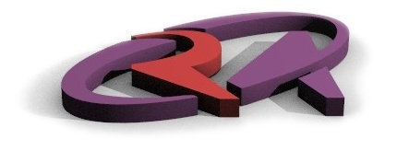
How to Join IEEE RAS
Apply online and receive membership number instantly at
http://www.ieee.org/membership_services/

