Slide 1

Robots Moving Closer to Humans
1/25
Bruno Siciliano
PRISMA Lab
Dipartimento di Informatica e Sistemistica
Università di Napoli Federico II
bruno.siciliano@unina.it
www.prisma.unina.it

Slide 2
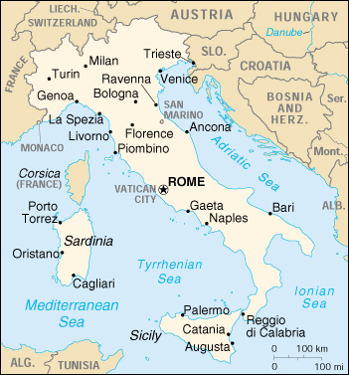
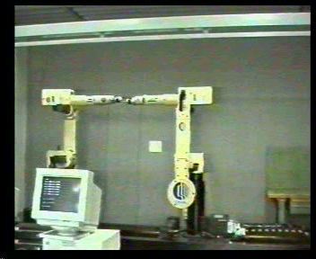



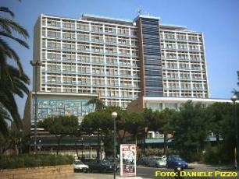
Università di Napoli Federico II
Robots Moving Closer to Humans 2/25
City
  1,200,000 inhabitants
  Pole of Mediterranean culture
  Historical and holiday sites
  5 universities + several science institutions
University
  Founded in 1224 by Emperor Federico II
  (oldest public university in Europe)
  100,000 students
  School of Engineering founded in 1811
  by King Murat (oldest in Italy)
    15,000 students
    (4,500 graduate)

Slide 3
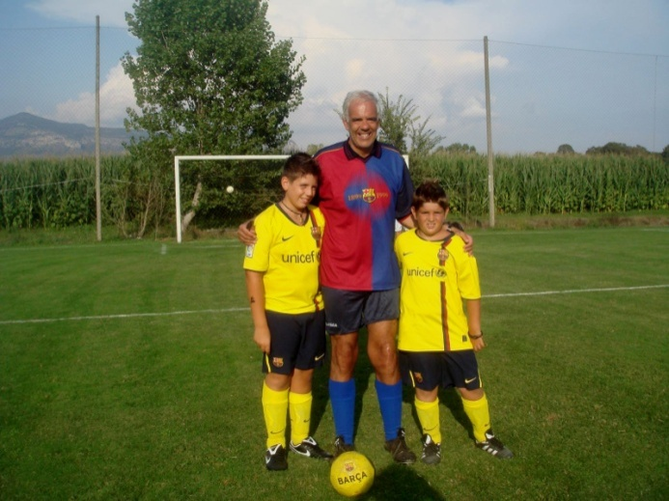
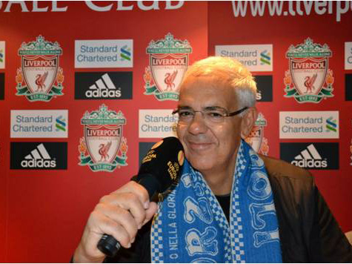
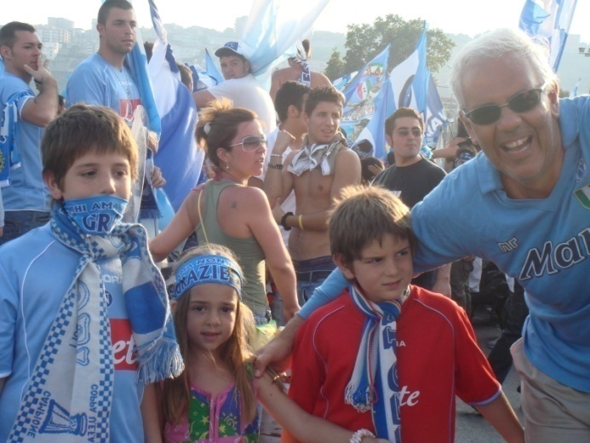
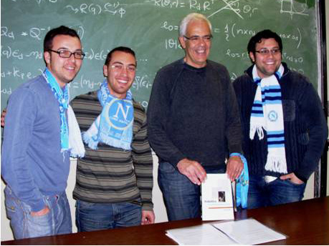

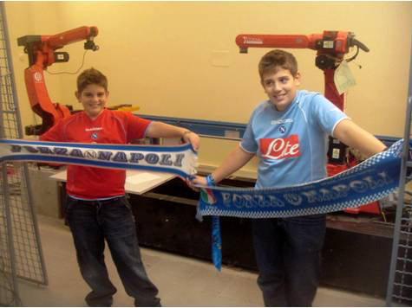
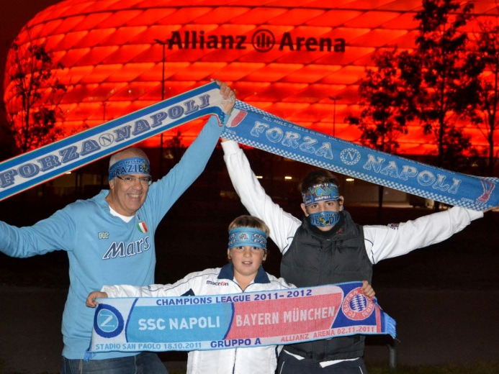
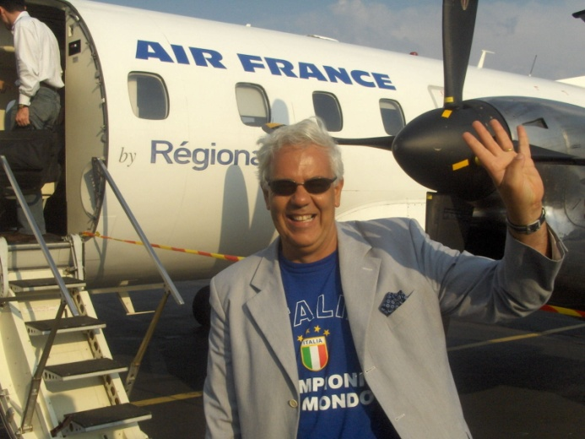
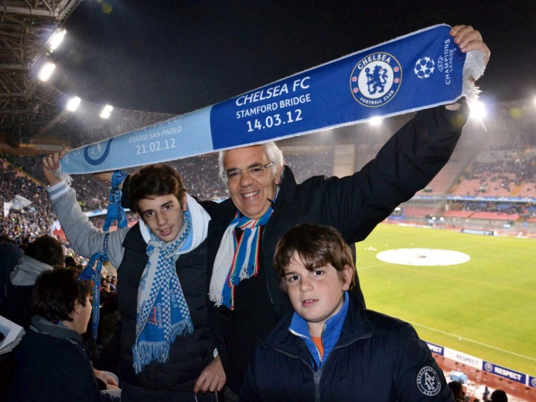
Madrid, Spain • October 2012

Slide 4

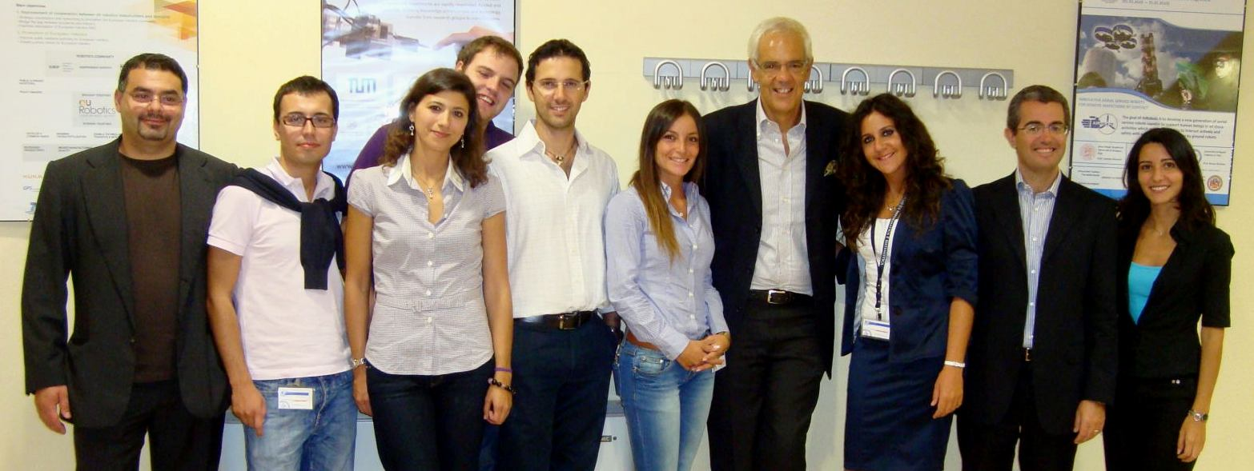
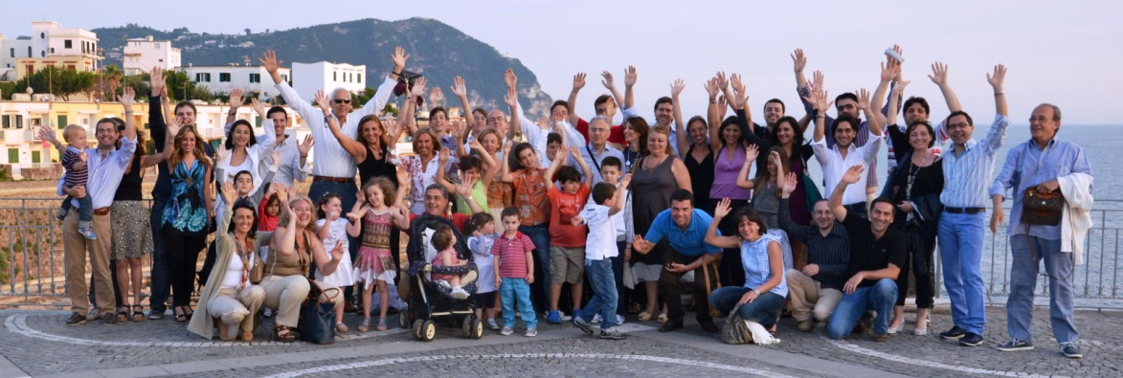
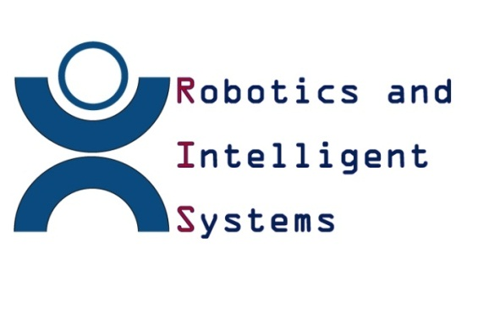
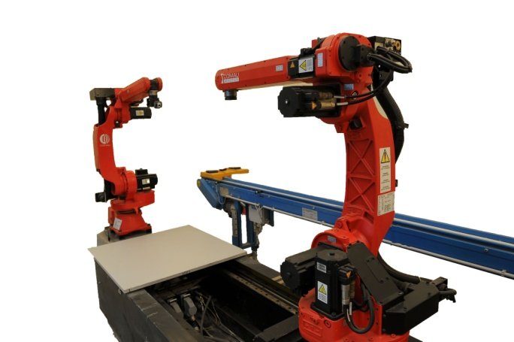
The PRISMA Team
Robots Moving Closer to Humans 4/25
6 Research teams (Napoli, Cassino, Salerno, Basilicata, Napoli 2, Roma 3)
4 Professors + 5 Associate Professors + 5 Assistant Professors
5 PostDoc + 7 PhD + 20 MS + 3 TechEng
30 years of research activity
1.5 MEuro financial support a year
Collaboration with 30 foreign institutions
150 seminars and invited talks
12 books + 15 volumes + 170 journal papers + 500 conference papers

Slide 5

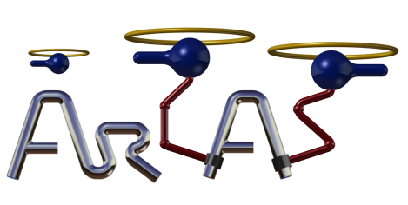


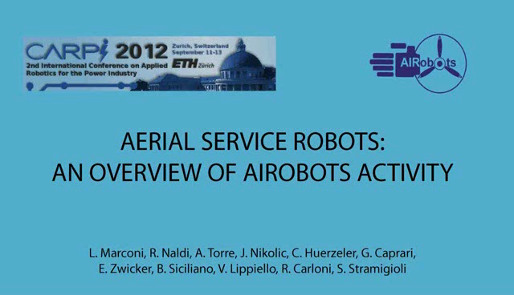

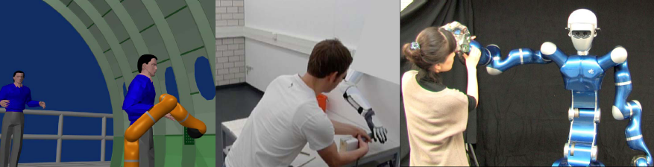

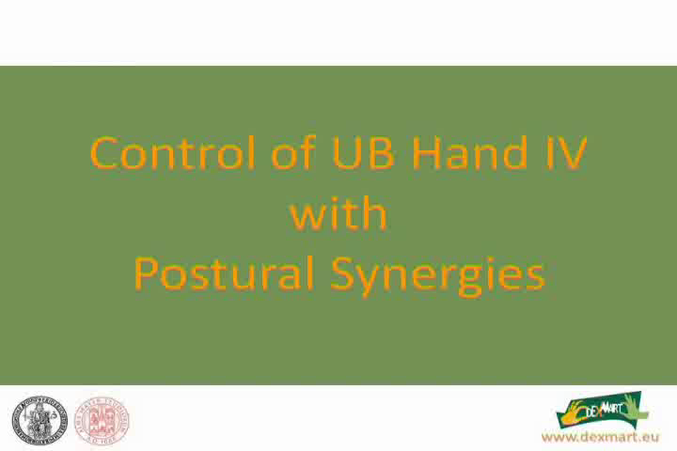

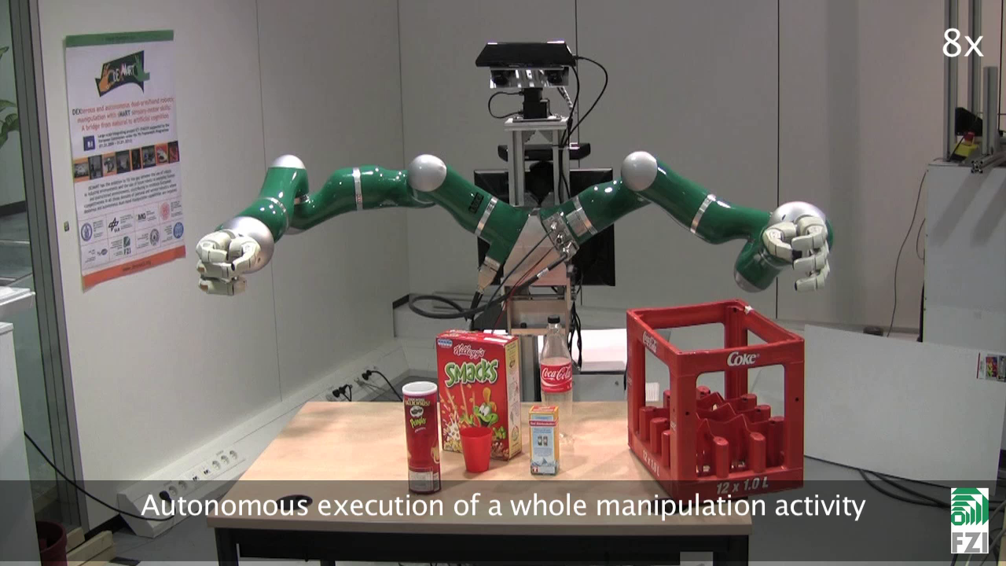




Research Portfolio
Robots Moving Closer to Humans 5/25
Aerial Robotics
Dual-Arm/Hand Manipulation
Control of Discrete Event Systems
Dynamic Parameter Identification
Fault Diagnosis and Fault Tolerant Control
Force Control
Human−Robot Interaction
Lightweight Flexible Arms and Space Robotics
Mobile Multirobot Systems
Mobile Robots
Novel Actuation and Sensing Systems for Robotic Applications
Redundant Manipulators
Service Robotics
Supervisory Control of Petri Nets
Underwater Robotics
Visual Servoing

Slide 6
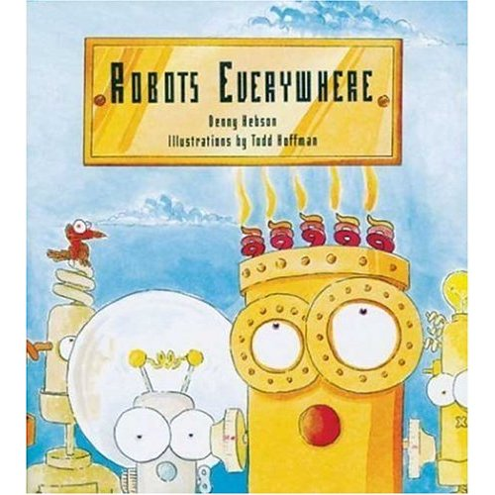
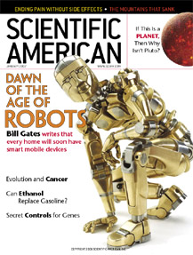
Robots !!!
Robots Moving Closer to Humans 6/25
Mars
Oceans
Hospitals
Factories
Schools
Homes
...
Tomorrow
Intelligent
Personal
Pervasive
Disappearing
Ubiquitous
Today

Slide 7
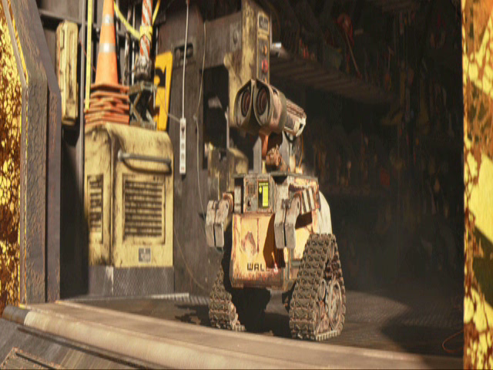
Definition of Robot
Robots Moving Closer to Humans 7/25
Robot (robota = subordinate work)
One of human beings' greatest ambitions has been to give life to their artifacts (mythology)
Man and woman in the street continue to imagine the robot as an android who can speak, walk, see, and hear (science fiction)
The robot is seen as a machine that, independently of its exterior, is able to modify the environment in which it operates (reality)

Slide 8
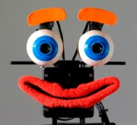
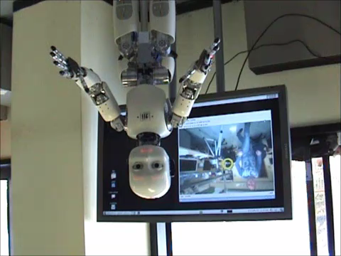
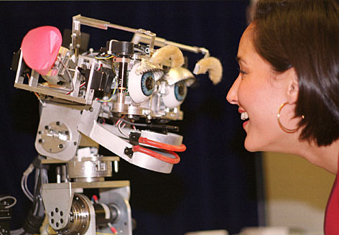
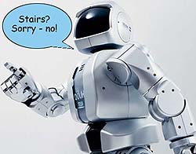
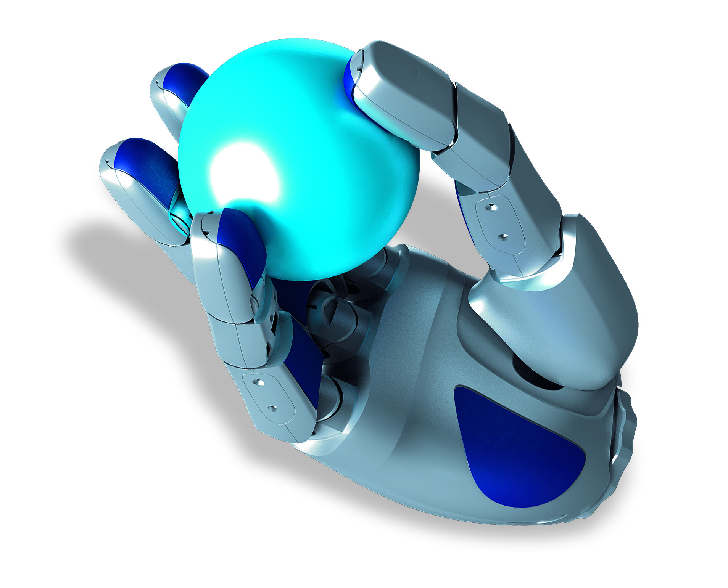
Robot Skills
Robots Moving Closer to Humans 8/25
object recognition capabilities of a
2-year-old child
language capabilities of a 4-year-old child
social understanding of an
8-year-old child
manual dexterity of a
6-year-old child

Slide 9
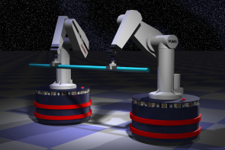
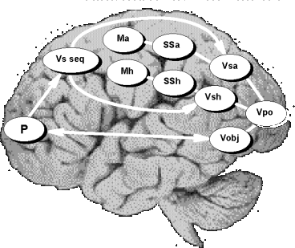
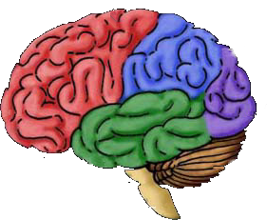
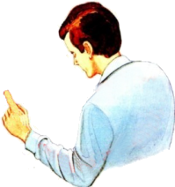
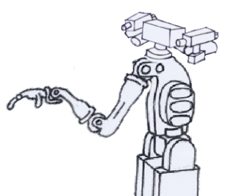

Definition of Robotics
Robots Moving Closer to Humans 9/25
INTELLIGENT
CONNECTION
ACTION
PERCEPTION
visual data
actuator commands
haptical data
arm/hand control

Slide 10
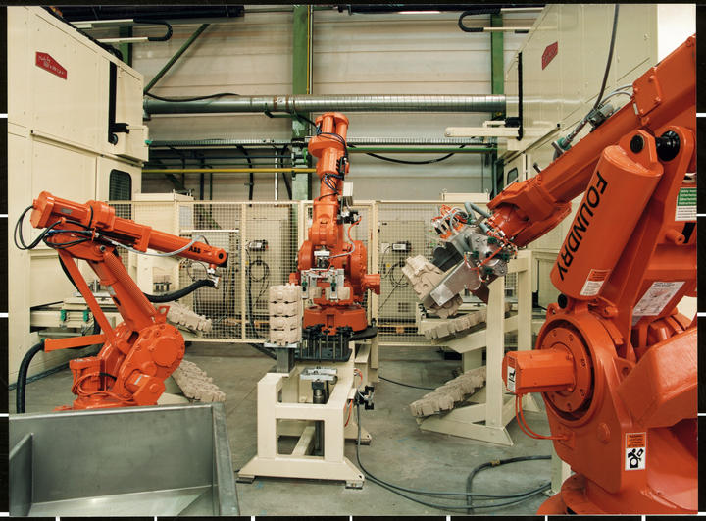
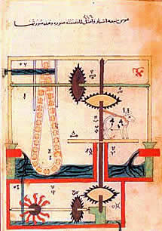
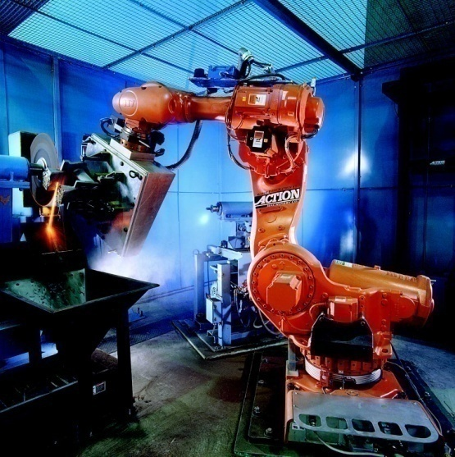
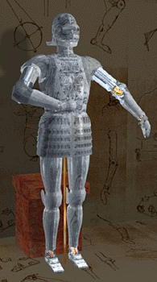
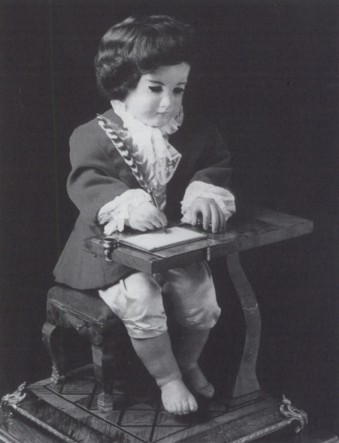
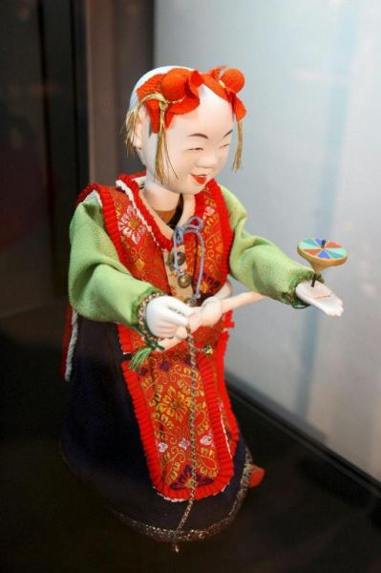
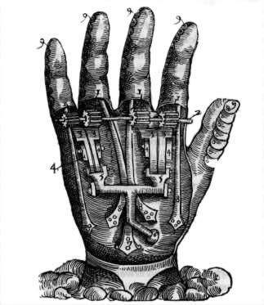
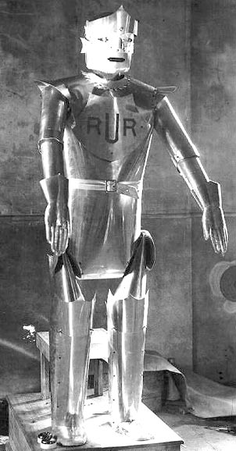
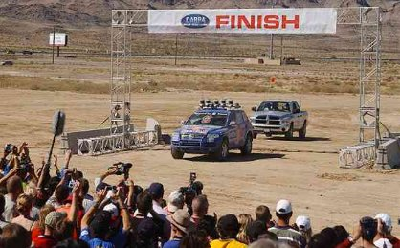
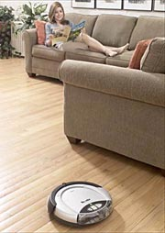
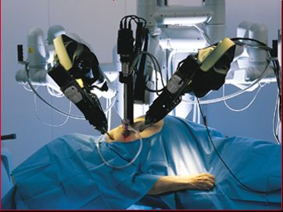
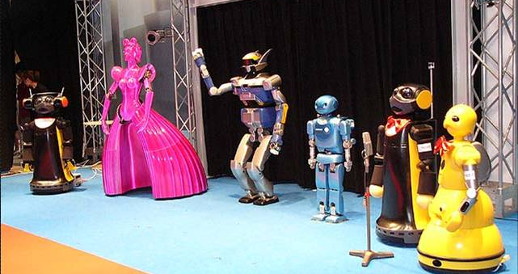
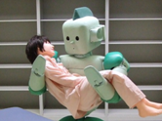
Evolution of Robotics
Robots Moving Closer to Humans 10/25
NEED for useful machines
Humans’ DREAM of replicating themselves
1960-1980
Manufacturing Applications
Industrial Robotics
1980-2000
Spatial Applications
1800
Field Robotics
1920
1990-2010
Medical Applications
Service Robotics
2005
2000-2020
1200
1500
Personal Robotics
?
1550
Humanoid Robotics
1750

Slide 11
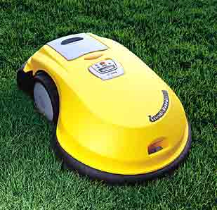
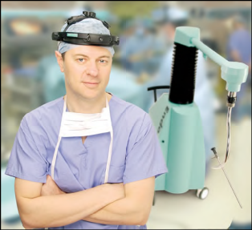
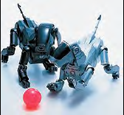
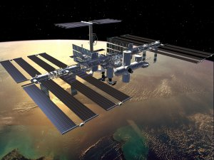




Well-Assessed Areas
Robots Moving Closer to Humans 11/25
Industry
Field
Service
Automotive
Chemical
Electronics
Food
Aerial
Space
Underwater
Search and rescue
Domestic
Edutainment
Rehabilitation
Medical
Level of Autonomy

Slide 12


Interesting Economics
Robots Moving Closer to Humans 12/25

Slide 13




Service Robots
Robots Moving Closer to Humans 13/25
Robots find applications in “4D tasks”
  Dull
  Dangerous
  Dirty
  Dumb
Service robots
  Health care
  Entertainment
  Security
  Personal assistance
  Construction
  Cleaning

Slide 14





Personal Robots
Robots Moving Closer to Humans 14/25
Service robots that are consumer products
  Education/hobbyist robots
  Entertainment robots
  Smart toys
  Robotic pets
  Automated home
  Partner robots

Slide 15







Biological Inspiration
Robots Moving Closer to Humans 15/25
«la scienza m’interessa proprio nel mio sforzo per uscire da una conoscenza antropomorfa; ma nello stesso tempo sono convinto che la nostra immaginazione non può essere che antropomorfa» Italo Calvino
human beings knowledge
humanoids
zoomorphic
BIOLOGY
biomechanics
neurosciences
psychology
ROBOTICS
mechanics
control
sensors
prostheses
cyborgs
hypotheses and models validation
micro/nano

Slide 16

New Emerging Areas
Robots Moving Closer to Humans 16/25
By dawn of new millennium, robotics has undergone a major transformation in scope and dimensions
  Maturity of field and advances in its related technologies
Expansion into challenges of human world (human-centered and life-like robotics)
  New generation of robots expected
  to safely and dependably co-habitat
  with humans in homes, workplaces,
  and communities, providing support
  in services, entertainment, education,
  healthcare, manufacturing,
  and assistance

Slide 17


Human-Robot Interaction
Robots Moving Closer to Humans 17/25
Intelligent machines working in contact with
humans (human augmentation)
  Haptic interfaces and teleoperators
  Cooperative material handling
  Power extenders
  Rehabilitation and physical training
  Entertainment
Advanced industrial robotics
  Traditionally segmented workspace for
  machines and humans
  Safe and productive human-aware
  space-sharing robot (cooperative, no fences)
Human-Robot Interaction (HRI)
  Cognitive issues [cHRI]: perception, awareness,
  mental models
  Physical issues [pHRI]: safety, dependability, dexterity
  Ethical issues: motivations and critics about HRI, acceptability

Slide 18
pHRI
Robots Moving Closer to Humans 18/25
Risks for robots interacting with humans
  Heavy moving parts and objects transported
  Sensory data reliability
  Level of autonomy/unpredictable behaviours
Solutions for collaborative human-robot operation
  Design of non-conventional actuators (passive safety)
  Interaction control (active safety)
  Dependable algorithms for supervision and planning
  Fault tolerance
  Need for quantitative metrics

Slide 19
Challenges and Outreach
Robots Moving Closer to Humans 19/25
Beyond its impact on physical robots, robotics has produced body of knowledge for much wider range of applications
  Biomechanics, haptics, neurosciences, virtual prototyping, animation, surgery, and sensor networks among others
  Challenges of new emerging areas proving abundant source of stimulation and insights for robotics field
  Most striking advances happening at intersection of disciplines
New communities of users and developers with growing connections to robotics research core
  Strategic goal for robotics community is one of outreach and scientific cooperation with these communities
  Future developments and expected growth of field will largely depend on research community’s abilities to achieve this objective

Slide 20

Looking Beyond
Robots Moving Closer to Humans 20/25
Roboethics
Human-centered ethics guiding design, construction and use of robots
Research challenges
  Biomechanics
  Haptics
  Neurosciences
  Machine learning
  Virtual prototyping
  Animation
  Surgery
  Sensor networks
  ...
Outreach toward new communities
  Growing connection with robotics research core

Slide 21

Dream or Reality?
Robots Moving Closer to Humans 21/25
Foreseen scenario
  Robots “disappear”
  Robotics technology becomes
  ubiquitous, distributed and/or
  “embedded” into smart
  environments and thinking things …
  just like computers which have
  become more and more pervasive

Slide 22

Springer Handbook of Robotics
Robots Moving Closer to Humans 22/25
B. Siciliano & O. Khatib (Editors)
Robotics
Foundations
(D. Orin)
A
  PROSE Awards for Excellence in Physical Sciences & Mathematics + Engineering & Technology (February 2009)
9
B
Sensing and
Perception
(H. Christensen)
Manipulation and
Interfaces
(M. Kaneko)
Robot
Structures
(F. Park)
C
D
Mobile and
Distributed Robotics
(R. Chatila)
E
9
7
9
8
Field and
Service Robotics
(A. Zelinsky)
F
VII
G
Human-Centered
and Life-Like
Robotics
(Rus)
Human-Centered and
Life-Like Robotics
(D. Rus)
14
8

Slide 23
The Handbook Story
Robotics @ PRISMA Lab 23/25
2nd Edition in progress …
expected to be published in 2014 ☺

Slide 24











































robots are
with us,
within us
and among us

Slide 25

شكرا جزيلا [:]
25/25

